Slide 1
Semantics for Healthcare Data

Slide 2




The problem
Clinicians, technologists, and guideline authors each work from their own viewpoint and related data
Specific but sometimes unstated assumptions
Specific terms with implied qualifications
Specialty specific concepts and terminology
Technology induced limitations
Yet understanding and sharing of information between then, accurately and contextually, is crucial
Automation depends on precision – making the implicit, explicit
Manual “data mappings” are slow, risky, and resource intensive
Clinical
Vocabulary
Guideline
Data Elements
HIT Data

Slide 3
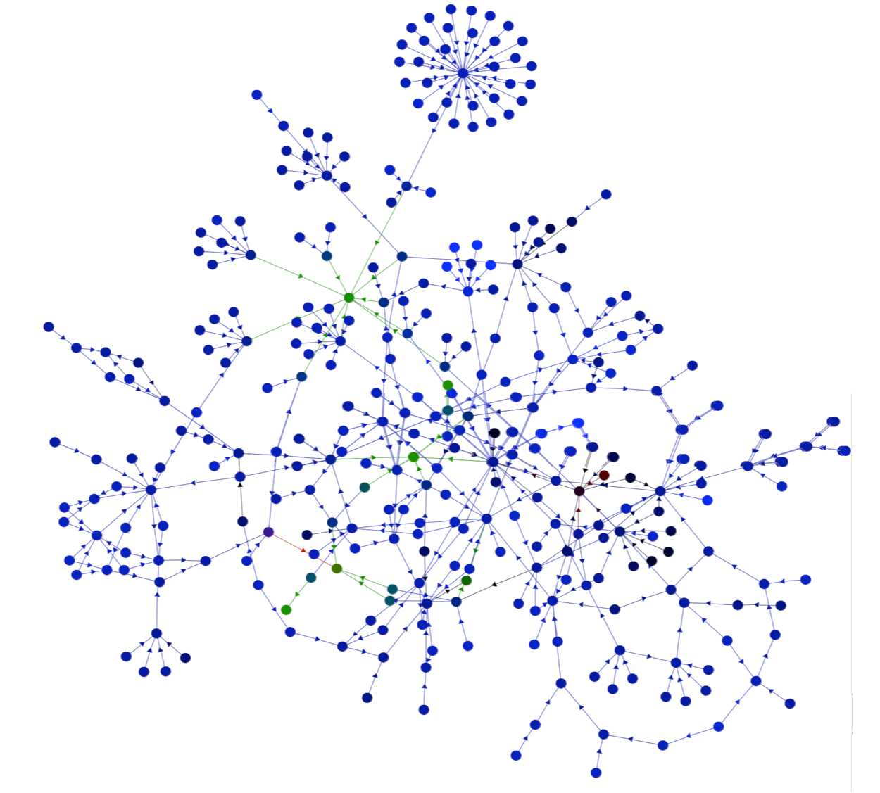
Our Proposition
The implicit can be made explicit
The concepts that underly healthcare can be formalized
We can bind the viewpoint specific vocabulary and situational data elements to these concepts
Resulting in
The situation specific vocabulary and data being precisely defined and expressible in natural language
increasing understanding and reducing risk
That the data connections among and between HIT, guidelines, and clinicians caring for patients can be automated
Reducing time, cost, and risk of integration
Clinical
Vocabulary
Guideline
Data Elements
Concepts
HIT Data
Binding

Slide 4
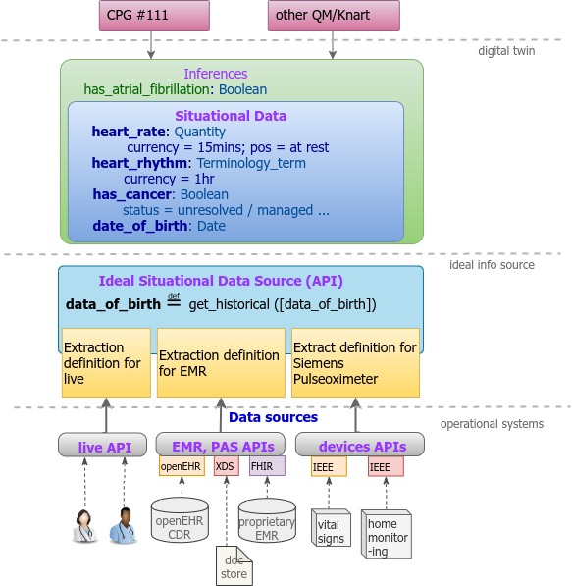
Connecting to real systems
The combination of the viewpoint “situational data elements”, the concepts and bindings can help automate integration using the systems and standards we already use
Clinical
Vocabulary
Guideline
Data Elements
Concepts
HIT Data
Binding

Slide 5
Requirements for the concept layer
Explicit representation of
The full physical systems, social constructs, and records of medicine
Multiple contextual dimensions: Who, What, Where, Why & When
Multiple layers of situations and context
How people, organizations, and things play roles in situations
Observations, projections, and expected values for measurements
Qualifiers of other concepts such as “current”, “projected” and “normal”
Inferences and diagnosis
Rules, guidelines and best practices
Uncertainty and likelihood
Facts and records of facts
Formal representation
Concepts

Slide 6
Requirements for the binding layer
The binding layer is responsible for “grounding” every “data element” in a viewpoint or schema to the set of concepts that define it
Defining a viewpoint as the foundation context for bindings
Binding specific kinds of situations to viewpoints
Potentially restricted in time or by other parameters
Qualification of concepts to the specific situation and data elements
Potentially parameterized based on the underlying concepts
Providing a “local vocabulary” of the restricted and qualified terms
Concepts
Binding

Slide 7
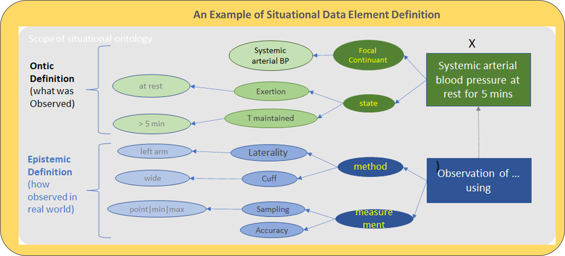
Example of a qualified concept
Blood pressure: The force of circulating blood on the walls of the arteries. Blood pressure is taken using two measurements: systolic (measured when the heart beats, when blood pressure is at its highest) and diastolic (measured between heart beats, when blood pressure is at its lowest).
What is blood pressure?
“BP” is
blood pressure
Qualified
BP SDE

Slide 8
Binding of blood pressure “Situational Data Element”
BP SDE
Clinical
Vocabulary
Guideline
Data Elements
Concepts
HIT Data
Binding

Slide 9
Binding to Data

Slide 10
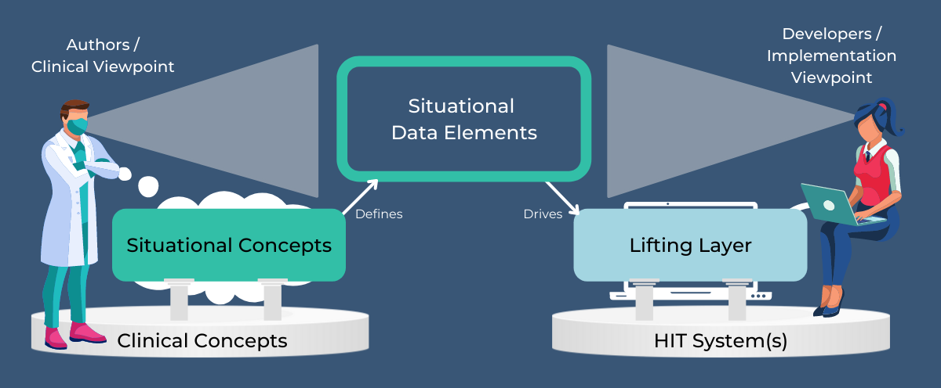
Lifting Layer
Clinical Concepts

Slide 11
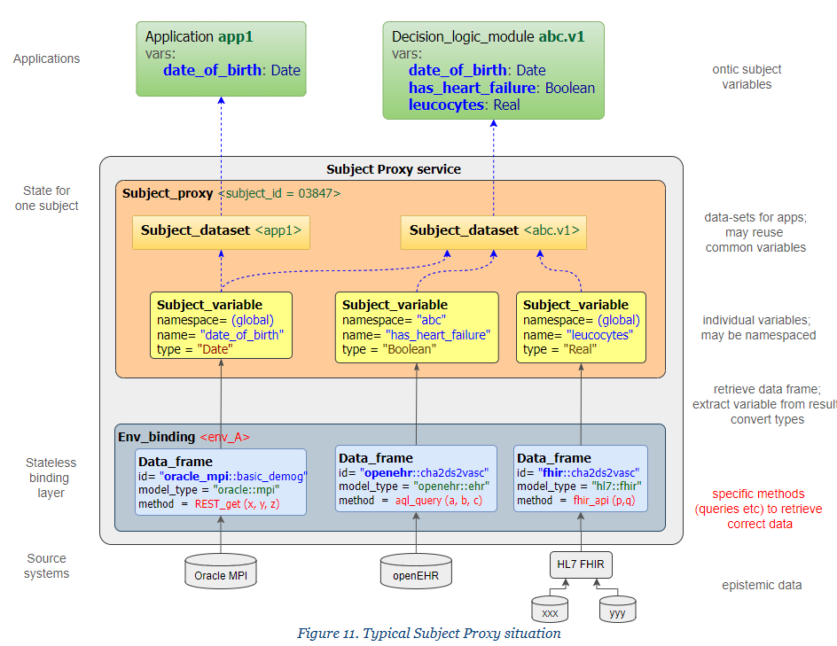
Is bound to
Defines mapping
Concepts
Is bound to

